Slide 1
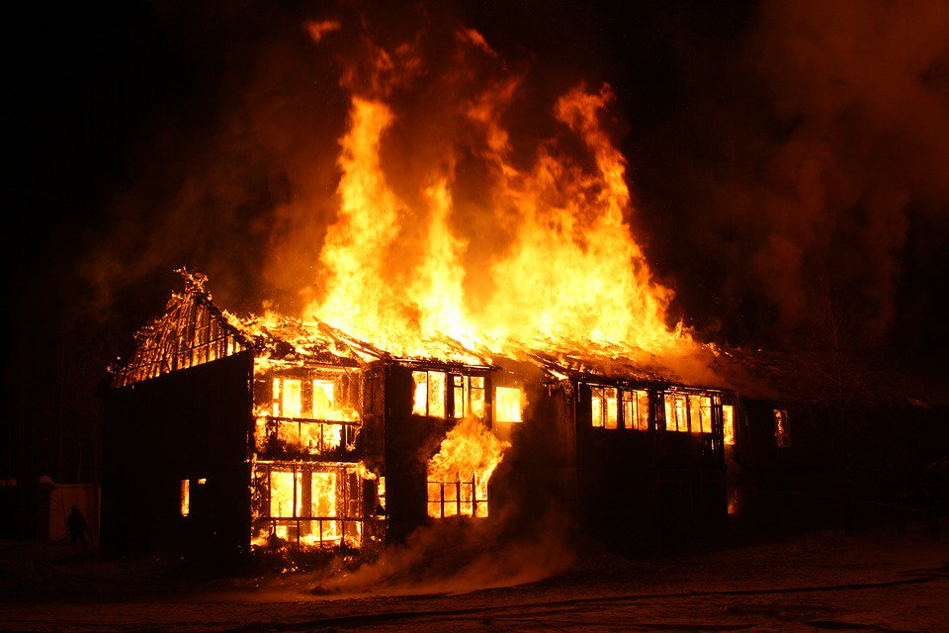
Burning Down the House
Show, Don’t Tell

Slide 2
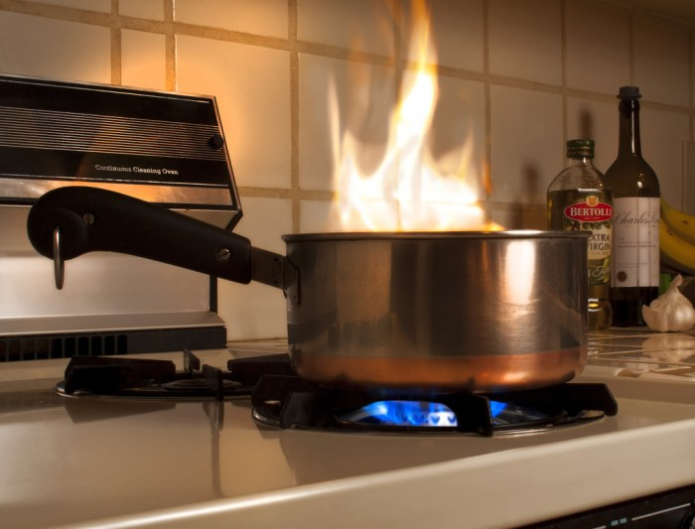
It’s all about letting dinner burn.

Slide 3
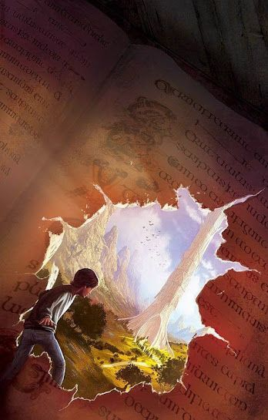
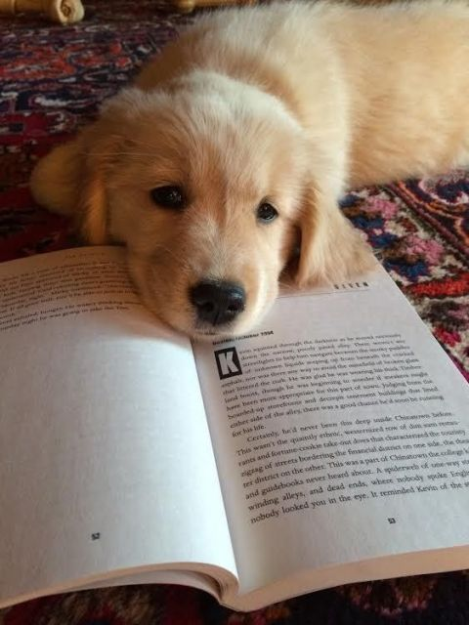
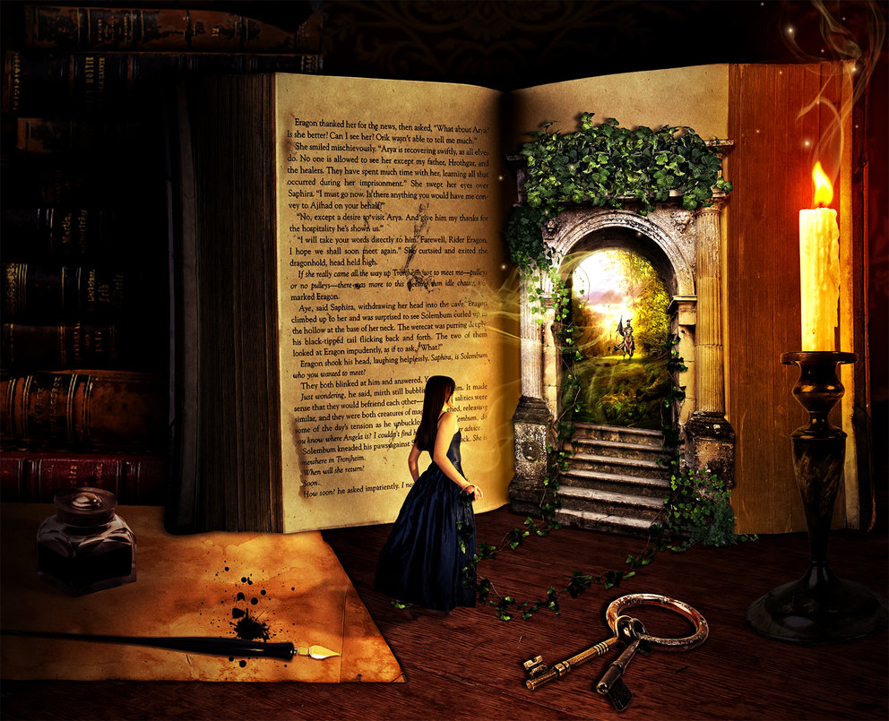
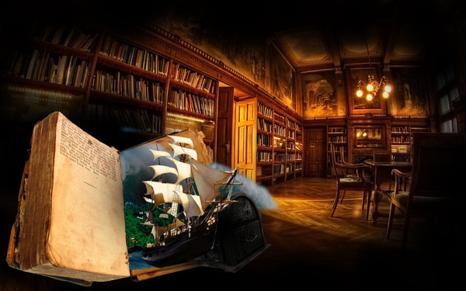

Slide 4
Show, Don’t Tell

Slide 5
Show, Don’t Tell
What does that mean?

Slide 6
Show, Don’t Tell
What does that mean?
When you tell instead of show, you simply inform the reader of something. They don’t experience it.

Slide 7
Show, Don’t Tell
What does that mean?
When you tell instead of show, you simply inform the reader of something. They don’t experience it.
Telling is boring.

Slide 8
Show, Don’t Tell
What does that mean?
When you tell instead of show, you simply inform the reader of something. They don’t experience it.
Telling is boring.
Showing draws the reader in. The goal is to make them so involved in your story that they stay up too late; they forget to get off the bus; they let dinner burn.

Slide 9
Anton Chekhov

Slide 10
Anton Chekhov
“Don’t tell me the moon is shining. Show me the glint of light on broken glass.”

Slide 11
Telling
The night was cold.

Slide 12
Showing
She’d known winters before, but never this far north and never this deep. Burrowed under furs as she was, she still felt her eyelashes freeze. There were crystals of ice on her face where her own breath had frozen solid.

Slide 14
Tell

Slide 15
Tell
Factual

Slide 16
Tell
Factual
Brief

Slide 17
Tell
Factual
Brief
Efficient

Slide 18
Tell
Factual
Brief
Efficient
Usually does not stir the heart.

Slide 19
Show

Slide 20
Show
Richer in detail

Slide 21
Show
Richer in detail
Not efficient

Slide 22
Show
Richer in detail
Not efficient
Loves detail

Slide 23
Show
Richer in detail
Not efficient
Loves detail
Engages the heart

Slide 24
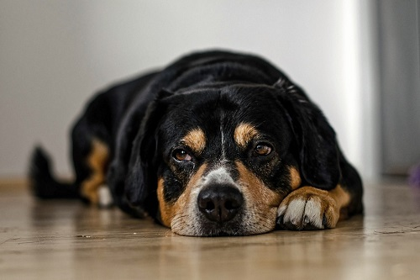
Tell My Uber driver is weird.

Slide 25
Tell My Uber driver is weird.
Show
As I climb into the car, the driver turns to me, looking like a deflated airbag and sounding like talk radio on repeat.

Slide 26
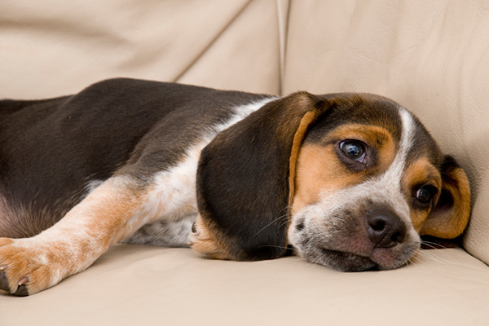
Tell The old man was crippled.

Slide 27
Tell The old man was crippled.
Show
He was bent into a capital C, his head leaning so far forward, his gray beard brushed his knees.

Slide 28
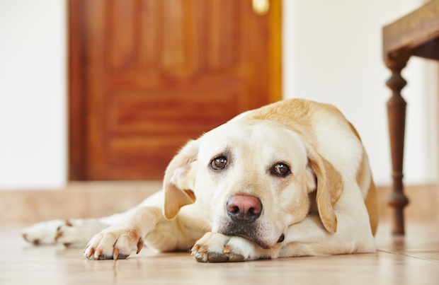
Tell I hate her.

Slide 29
Tell I hate her.
Show
When she stood to speak, I sank in my chair. There was nothing she was going to say that I wanted to hear.

Slide 30
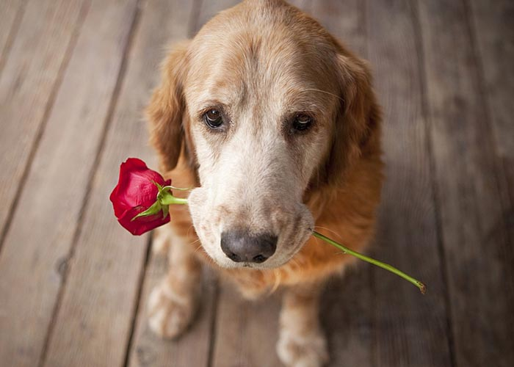
LOVE (LIKE)

Slide 31
LOVE (LIKE)
I like my hamburgers a little burnt.

Slide 32
LOVE (LIKE)
I like my hamburgers a little burnt.
I did the dishes.

Slide 33
LOVE (LIKE)
I like my hamburgers a little burnt.
I did the dishes.
No, your hair’s not too short.

Slide 34
LOVE (LIKE)
I like my hamburgers a little burnt.
I did the dishes.
No, your hair’s not too short.
Take my jacket; I’m not cold at all.

Slide 35
LOVE (LIKE)
I like my hamburgers a little burnt.
I did the dishes.
No, your hair’s not too short.
Take my jacket; I’m not cold at all.

Slide 36
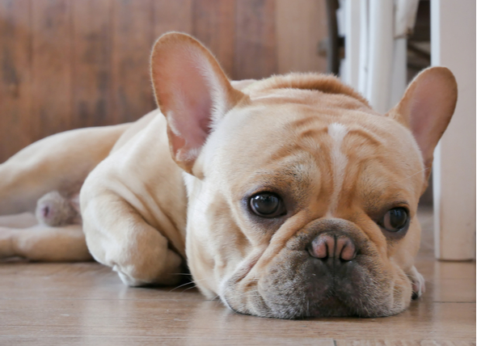
SAD

Slide 37
SAD
I don’t feel like eating ice cream today.

Slide 38
SAD
I don’t feel like eating ice cream today.
The dog’s ears sagged like a popped balloon.

Slide 39
SAD
I don’t feel like eating ice cream today.
The dog’s ears sagged like a popped balloon.
Kimo put his hands in his pockets. “I nevah like play anyway,” he muttered, turning toward his house. Billy-dem just laughed.

Slide 40
SAD
I don’t feel like eating ice cream today.
The dog’s ears sagged like a popped balloon.
Kimo put his hands in his pockets. “I nevah like play anyway,” he muttered, turning toward his house. Billy-dem just laughed.
“Oh, you pau beach already?” I said. “I just got here.”

Slide 41
SAD
I don’t feel like eating ice cream today.
The dog’s ears sagged like a popped balloon.
Kimo put his hands in his pockets. “I nevah like play anyway,” he muttered, turning toward his house. Billy-dem just laughed.
“Oh, you pau beach already?” I said. “I just got here.”

Slide 42
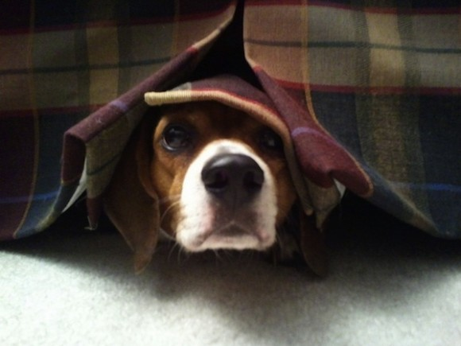
AFRAID (DARK / SCARY)

Slide 43
AFRAID (DARK / SCARY)
Her breath was the color of tombstones.

Slide 44
AFRAID (DARK / SCARY)
Her breath was the color of tombstones.
The nicotine trees crowded the pathway as a cancerous fog approached.

Slide 45
AFRAID (DARK / SCARY)
Her breath was the color of tombstones.
The nicotine trees crowded the pathway as a cancerous fog approached.
A chill shivered down my arm as though a thousand spiders were coming home.

Slide 46
AFRAID (DARK / SCARY)
Her breath was the color of tombstones.
The nicotine trees crowded the pathway as a cancerous fog approached.
A chill shivered down my arm as though a thousand spiders were coming home.
“Who’s there?” I called into the empty house.

Slide 47
AFRAID (DARK / SCARY)
Her breath was the color of tombstones.
The nicotine trees crowded the pathway as a cancerous fog approached.
A chill shivered down my arm as though a thousand spiders were coming home.
“Who’s there?” I called into the empty house.

Slide 48
Show (Not Tell) Challenge
It was a dark and stormy night.
Pualani didn’t want to do her homework. She wanted to make up a song about the ocean.
Kalani was mad at Maka and didn’t want to talk.
It was cold in the house.
WILD CARD: write a sentence that tells and then rewrite that sentence using words that show.

Slide 49
Share, Critique, Revise, Share
Find a partner
Share stories
Discuss what you like
Consider word choice
Brainstorm
Revise
Share again

